Slide 1
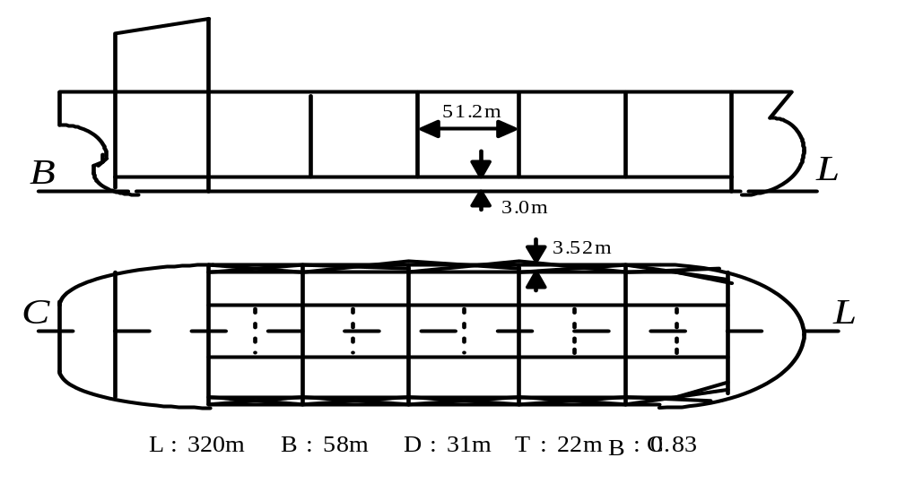
LBR5 --> Optimization of a Tanker
Application - Example
L=320m B=58m D=31m T=22m C_{B}=0.83
Notes:
This is a VLCC Built in Korea by Daewoo (1990’s). East Asian routes. T is scantling Draft

Slide 2
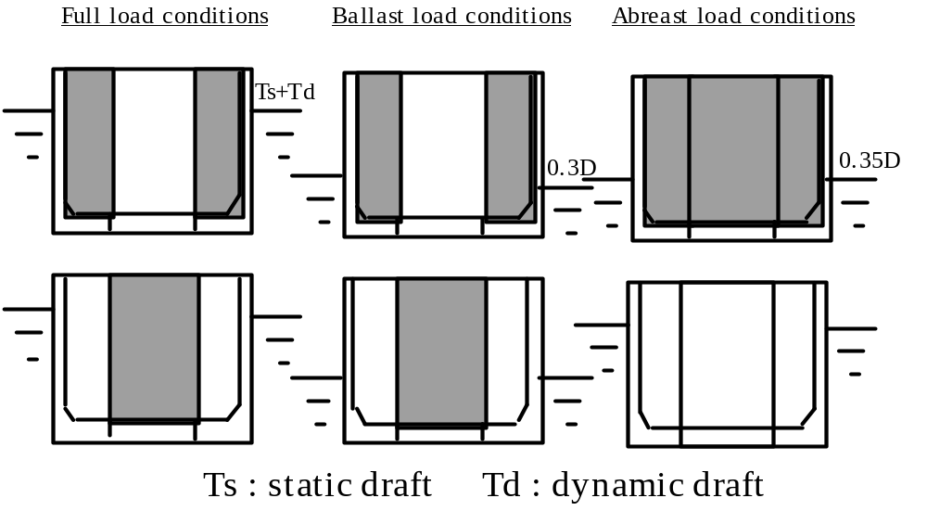
Application --> Tanker
Notes:
Loading Conditions: Six transversal loading conditions combined with global bending ( hogging and sagging). Total loading conditions = 12

Slide 3
LBR5 --> Optimization of a Tanker
System definition
Notes:
Design the web frames, scantlings no. of stiffeners etc. General arrangements are fixed as “Z” parameters.
Given : L B D T Cb, Hold length given 51.2m, Double bottom height 3.0 m, side shell double wall side3.52

Slide 4
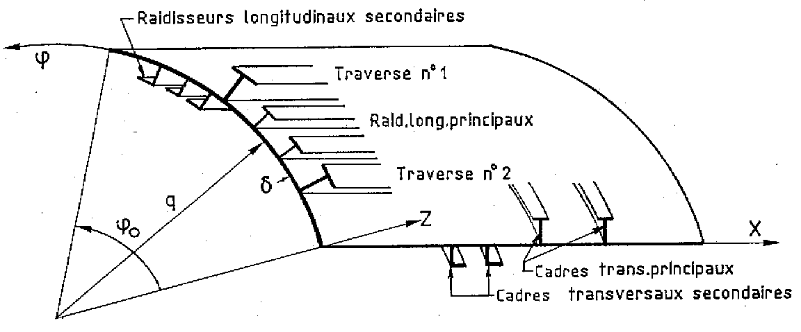
LBR-5 --> Product model
1 STIFFENED PANEL- 9 design variables -
Auxiliary Longitudinal Stiffeners
Girder n° 1
Main Longitudinal Members
Girder n° 2
Main Transversal Frames
Auxiliary Transversal Stiffeners
Notes:
Plate thickness, trans frame: spacing, web ht, web thickness, flange width ; longitudinals: spacing, web ht, web thickness, flange width

Slide 5
Design Variables
  Shell plate thickness
  Longitudinals
    Sizes (web and flange)
    Spacing
  Web Frames
    Sizes (web and flange)
    Spacing

Slide 6
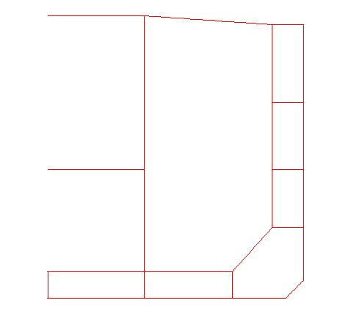
LBR-5 --> Design Variables
423 design variables (9 x 47 panels).
- 70 to 250 equality constraints.

Slide 7
6
5
4
3
2
1
29
Symmetry axis
45
39
LBR-5 --> modeling
28
44
38
49
PANELS
NODES
43
37
A Framework for Simulation Based Design of Ship Structures
42
36
52
53
27
48
26
41
35
34
40
46
25
33
24
31
32
13
14
15
16
17
18
21
23
7
8
9
10
11
12
30
Notes:
Fourier series analysis of stiffened plates. One-half model due to symmetry

Slide 8
LBR-5 --> Process Model
COST-LBR5:
Unitary material, fabrication costs and Unitary working loads:
k = Unitary Labor Cost (€/m-h) / Material Cost (€/t)
= 0.08 (in Europe) or 0.03 (in Korea)
*** Unitary price of steel: C1 = 1.00 €/kg,
*** Unitary price of welding (materials only): C8 = 2.00 €/m,
*** Unitary working load (labor):
    Plate assembling: P10 = 0.25 m-h/m²,
    Welding stiffeners on the panel: P4 = 0.5m-h/m,
    Welding frames on the panel: P5 = 1.5 m-h/m,
    Built the members: P9=1.5 m-h/m (if built on site),
    Slot for stiffener: P6 = 0.6 m-h/piece,
    Bracket or web stiffener: P7 = 0.6 m-h/piece.

Slide 9
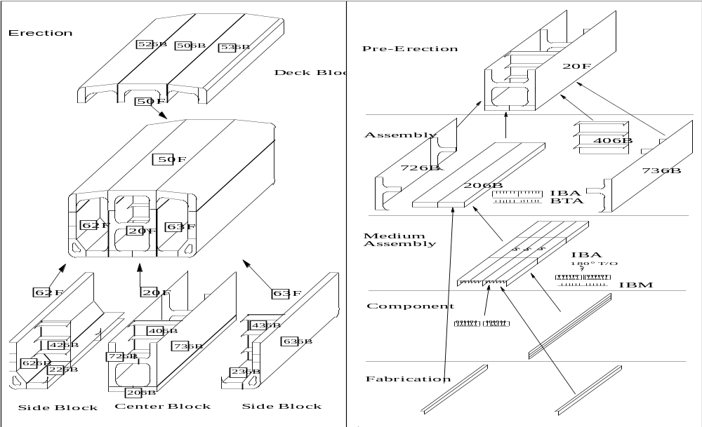
LBR5 (COSTCAT)

Slide 10
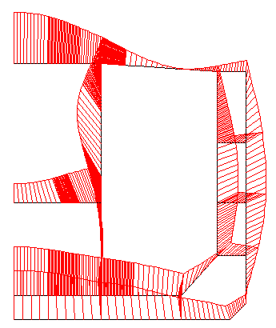
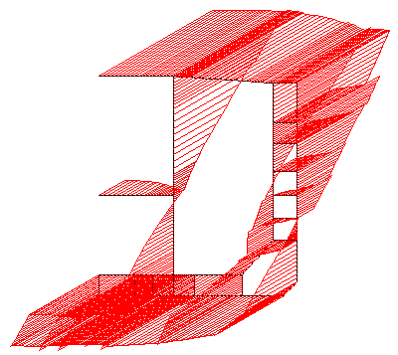
LBR-5 --> Simulation response

Slide 11
LBR-5 --> Design Criteria ( G )
The R Response Metrics
• 2015 structural constraints (5 load cases; 8~11 constraints per panel);
• 2 constraints on the hull ultimate bending moment;
• 1 constraint on the vertical position of the gravity center,
• 198 geometrical constraints (7 x 47 panels).
The G Constraint acceptance criteria:
• Against yielding the criteria is : σ(von Mises) < 1.0 Yield Stress.
• For plate buckling: σ(effective) < 1.0 σ(buckling) .
• For stiffened panel (axially compressed):
σ(effective) < 0.8 σ(ultimate strength).
• For ultimate bending moment of hull girder (in sagging and hogging):
M(required by Class. Soc.) < 0.8 M (Ultimate Bending Moment)
• Position of the gravity center

Slide 12
LBR-5 --> Optimization Algorithm
Responses → Implicit & Non Linear
Weight or Cost
CONSTRAINED PROBLEM
→ CONVEX LINEARIZATION ←
--> CONLIN
Responses → Explicit & Linear
CONSTRAINED PROBLEM
→ DUAL APPROACH ←
Unconstrained, Explicit & Linear
Problem → EASY
Needs only 10 iterations.
Convergence in Feasible Space

Slide 13
LBR5 --> Optimization of a Tanker
COST 1000 US$
Least Cost
6300.0
Comparison
Least Cost /
Least Weight
- USA/Europe -
6200.0
Least Weight
6100.0
6000.0
5900.0
5800.0
5700.0
Least weight
Least Cost
Initial POINT
5600.0
5600.0
Least Cost
5500.0
5400.0
3.75
4
4.25
4.5
4.75
5
5.25
5.5
5.75
6
Least Cost
Frame space (m)
5200.0
5000.0
Weight (tons)
4800.0
4600.0
Least weight
4400.0
LEAST WEIGHT
Initial POINT
4200.0
Least Cost
4000.0
Least Weight
3.75
4
4.25
4.5
4.75
5
5.25
5.5
5.75
6
Frame space (m)
Notes:
Weight is for one hold (without transverse bulkhead)

Slide 14
LBR5 --> Optimization of a Tanker
USA/Europe
6300.0
COST 1000 US$
Comparison
Least Cost in Europe/
Least Cost in Asia
6200.0
Least weight
6100.0
6000.0
5900.0
5800.0
Least Cost (k=0.08)
5700.0
Least weight
Initial POINT
5600.0
Least Cost
5500.0
4100.0
COST 1000 US$
3.75
4
4.25
4.5
4.75
5
5.25
5.5
5.75
6
Frame space (m)
4050.0
Least weight
4000.0
Least weight
3950.0
Initial POINT
ASIA and
Countries with
low labor cost
Least Cost
3900.0
Least Cost (k=0.03)
3850.0
3.75
4
4.25
4.5
4.75
5
5.25
5.5
5.75
6
Frame space (m)
Notes:
Cost is for one hold (hull material and fabrication w/ labor)

